Slide 1



Presented by Youssef El Aissaoui
2022-2023
Internship project
Development of a web application for internships management

Slide 2
Contents
01 - General Context
02 - Specification of requirements
03 - Conception design
The host company
The problematic
Methodology of work
Functional requirements
Non functional requirements
Actors in the system
UML Diagrams
Application Architecture
04 - The Development
05 - The Application
06 - Conclusion
Tools
Technologies
Live review of the application

Slide 3
The host company
NTT DATA, part of a partially-owned subsidiary of Nippon Telegraph and Téléphone (NTT), founded in 1988, is one of the world's top 10 IT service providers, headquartered in Tokyo (Japan), with over 140,000 professionals and operations in more than 50 countries.
NTT DATA supports its customers in their digital development through a wide range of consulting and strategic advisory services, advanced technologies, applications, infrastructure, IT modernization and BPO.

Slide 4
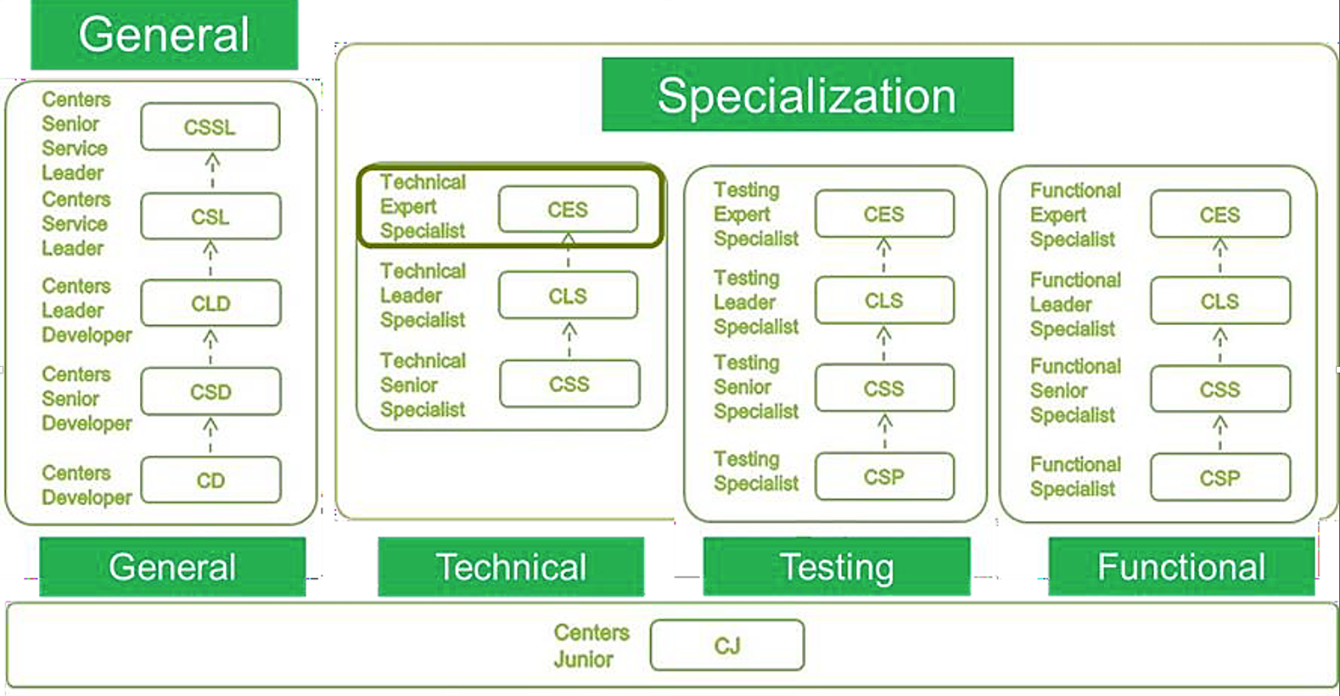
The Organization Hierarchy

Slide 5
The Problematic
Managing internships within a company can be a complex and time-consuming task. The traditional manual methods of tracking, coordinating, and evaluating internships often lead to miscommunication, and a lack of information. This can result in difficulties in matching interns with suitable projects, monitoring their progress, and providing a meaningful learning experience. To overcome these challenges, a more efficient and automated system was required.

Slide 6
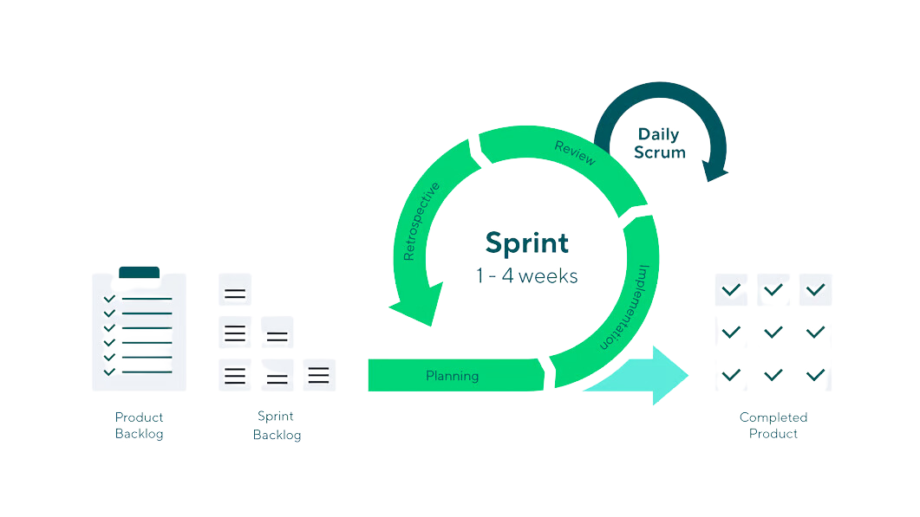
Methodology of work

Slide 7

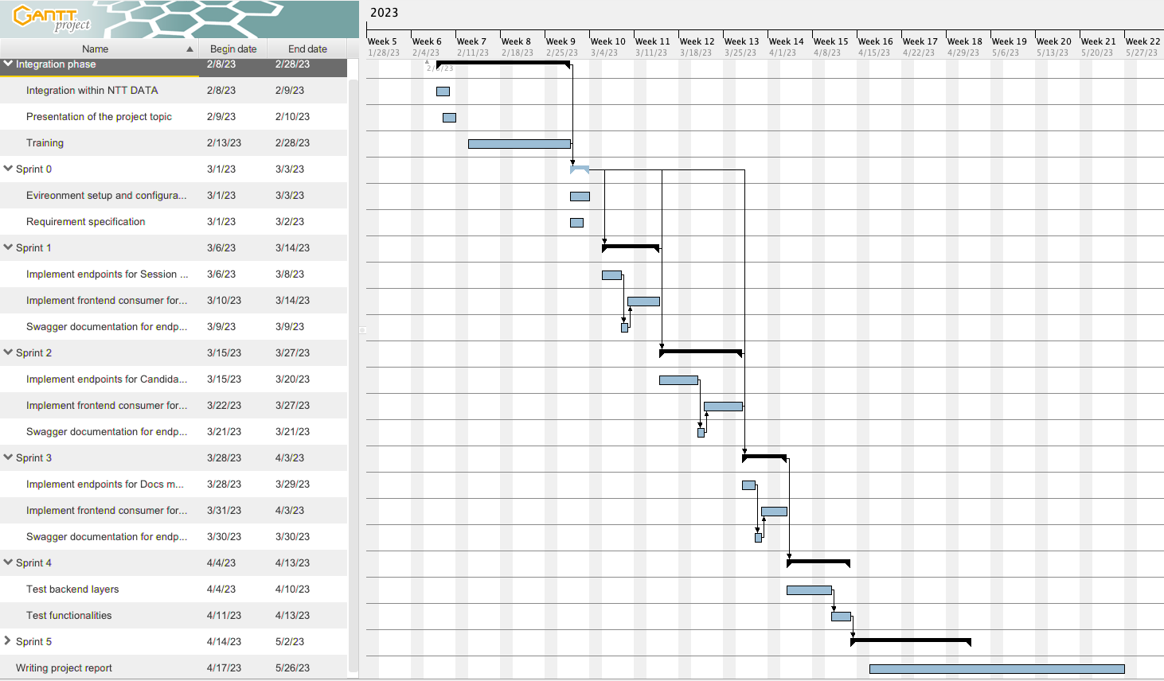
Gantt Diagram

Slide 8
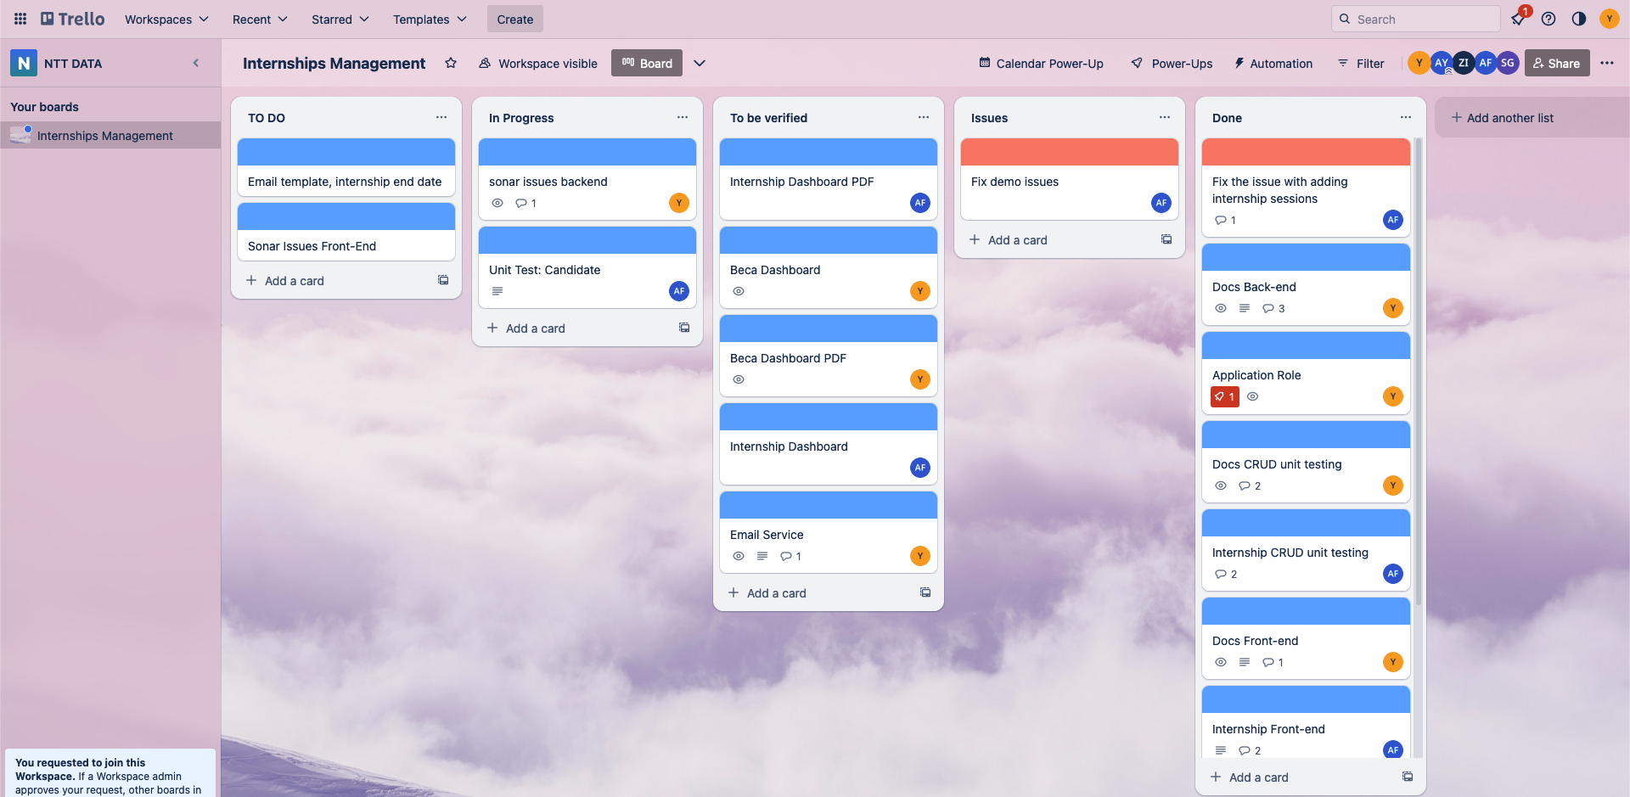
Trello, for tasks management

Slide 9
Specification of requirements
Actors of the system
Functional requirements
Administrator
Internship manager
Administrator
Managing users
Generate reports and analytics
Internship manager
Manage internship sessions
Add new candidates
Accept/reject candidates
Create internships for candidates

Slide 10
Scalability
Accessibility
Non functional
requirements
Performance
Maintainability
Security
Simplicity

Slide 11
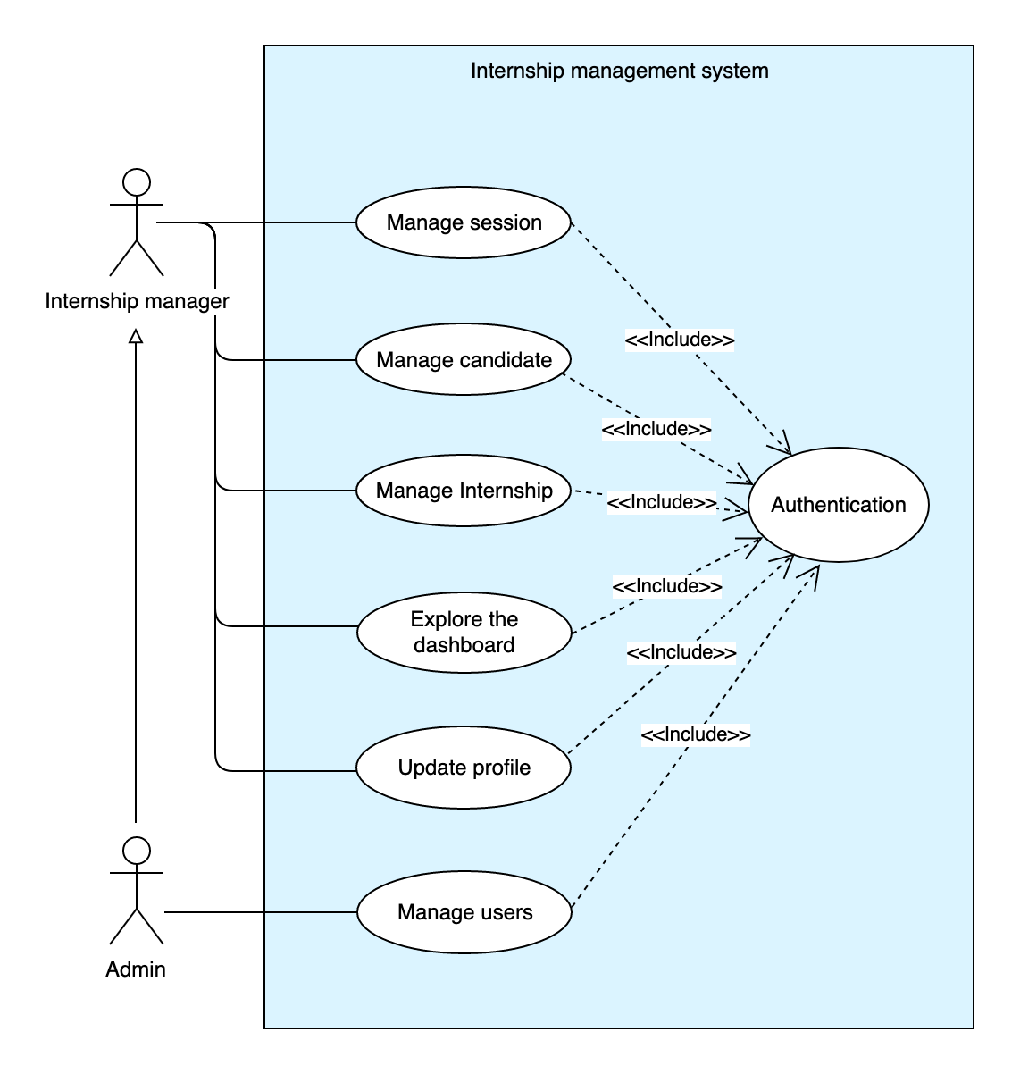
Conception design &
Analysis
General Use case Diagram

Slide 12
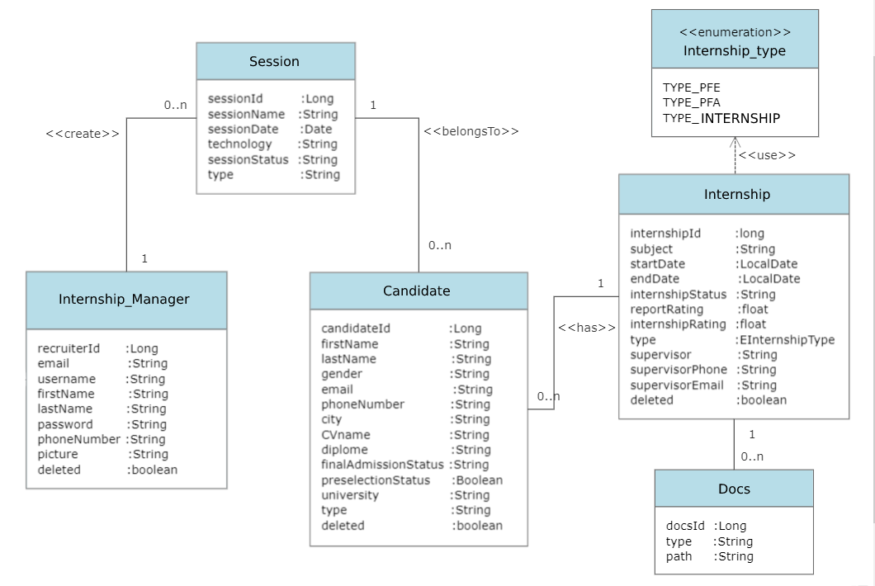
Class Diagram

Slide 13
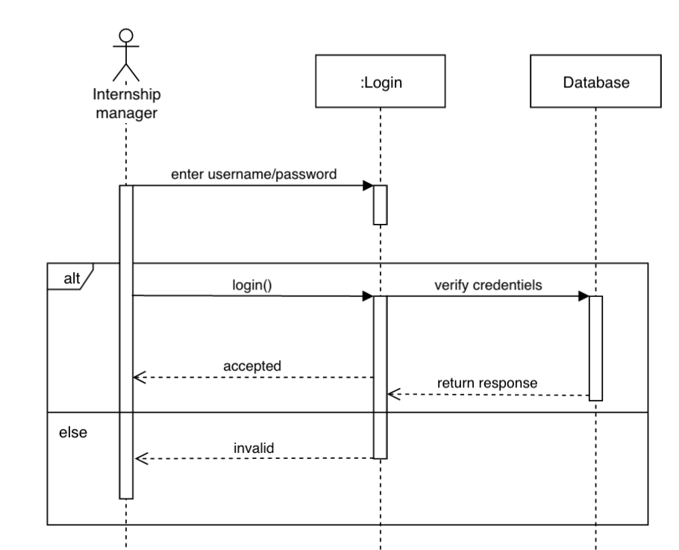
Authentication
Sequence Diagram

Slide 14
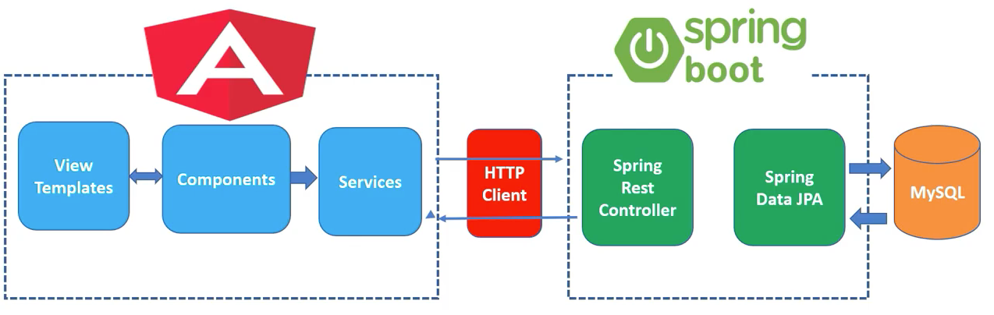
Application Architecture

Slide 15












The Developement
(tools & technologies)
Back-end
Front-end
Tools
Testing

Slide 16

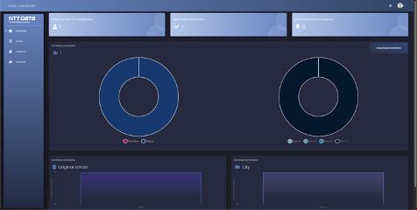
The Application
Live review of the project results

Slide 17
Conclusion

Slide 18
Thank You
Youssef El Aissaoui
www.isawi.me
yusufisawi@gmail.com

